Slide 1


Maths
Measurement
Year One
Maths | Year 1 | Measurement | Measure and Record Length and Height | Lesson 2 of 2: Metres and Centimetres

Slide 2

Metres and Centimetres

Slide 3
Aim
I can measure length and height using standard units.
Success Criteria
I can measure lengths and heights.
I can use the words ‘metre’ and centimetre’.

Slide 4

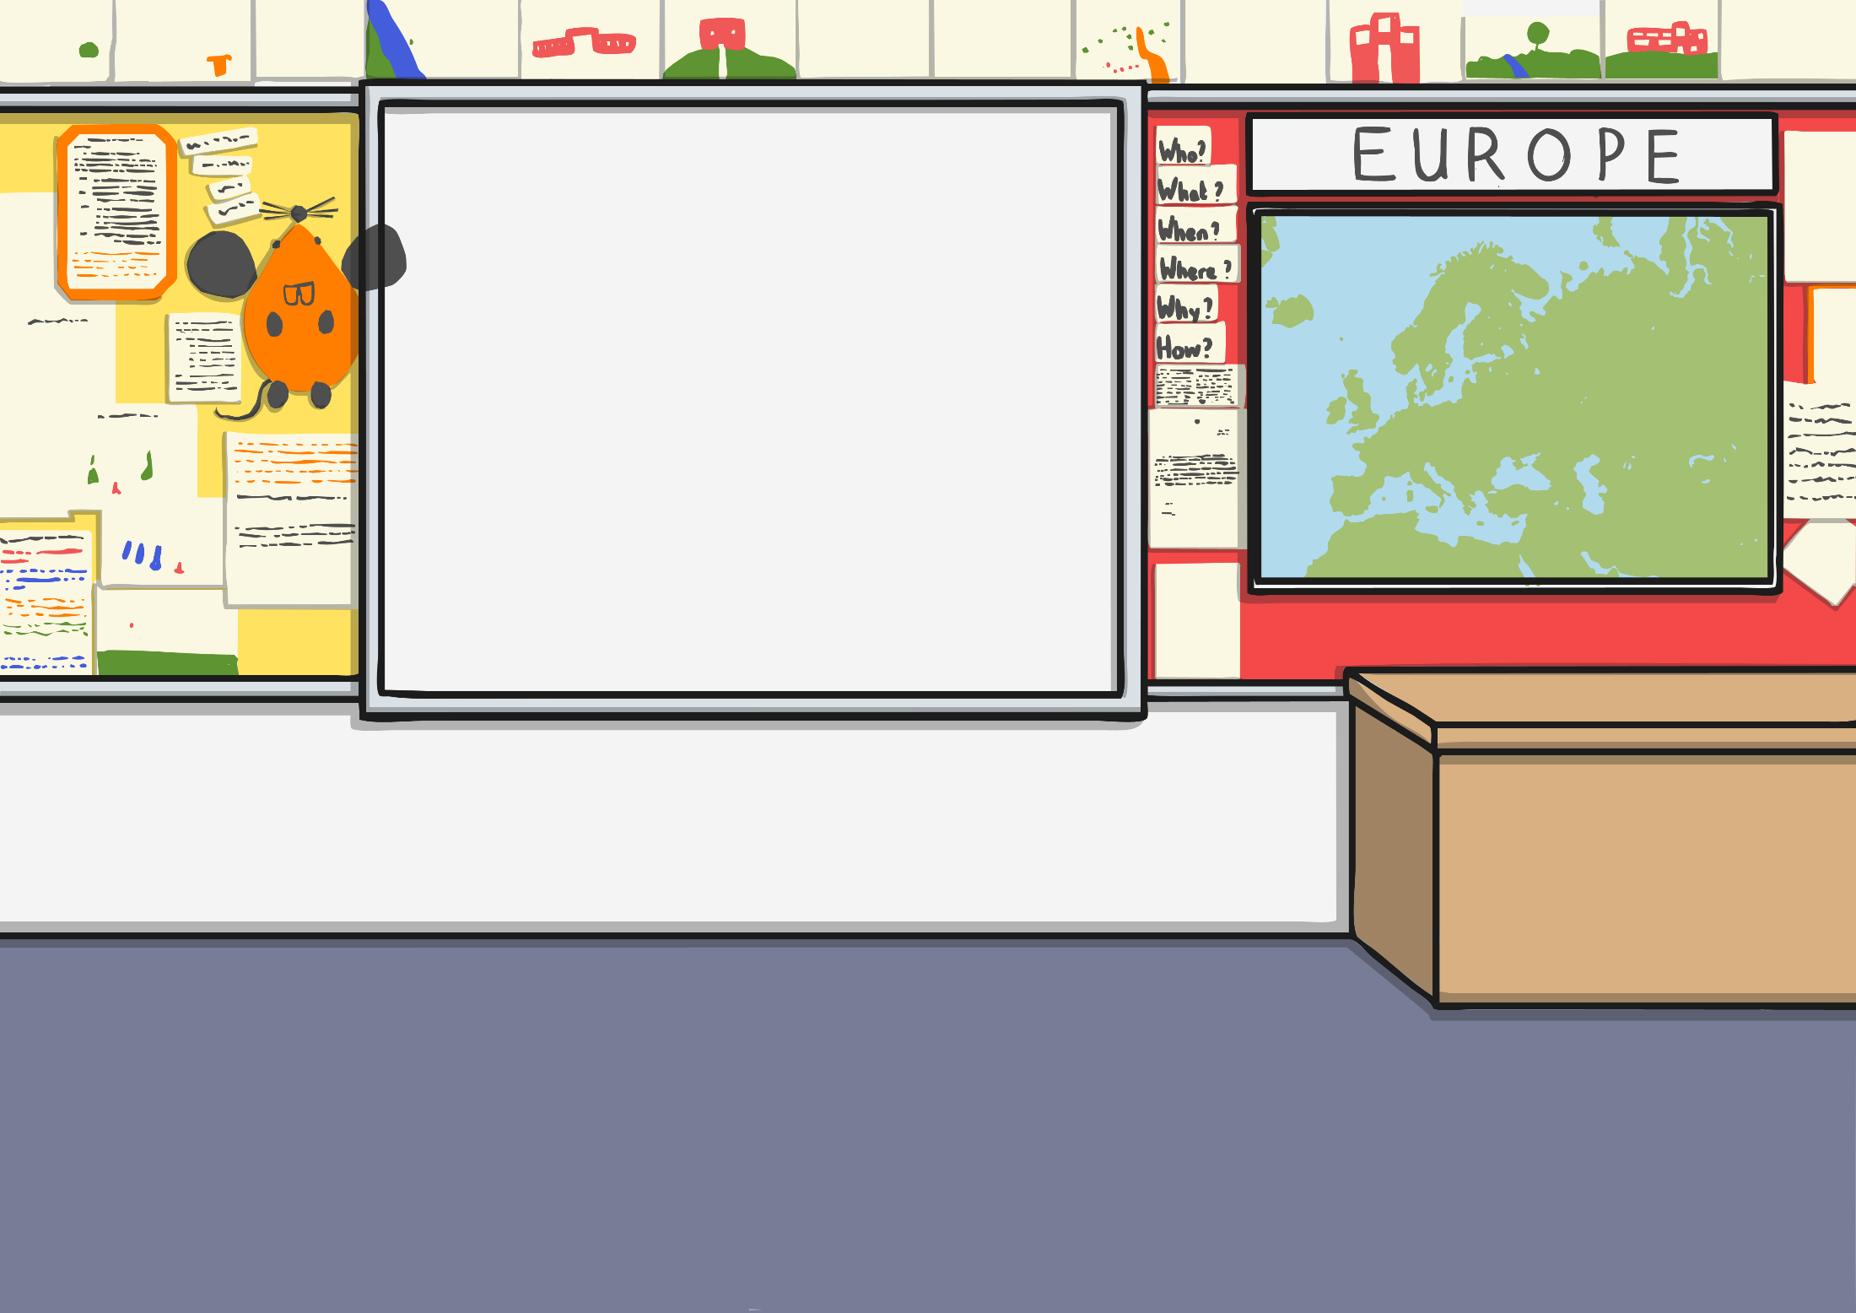
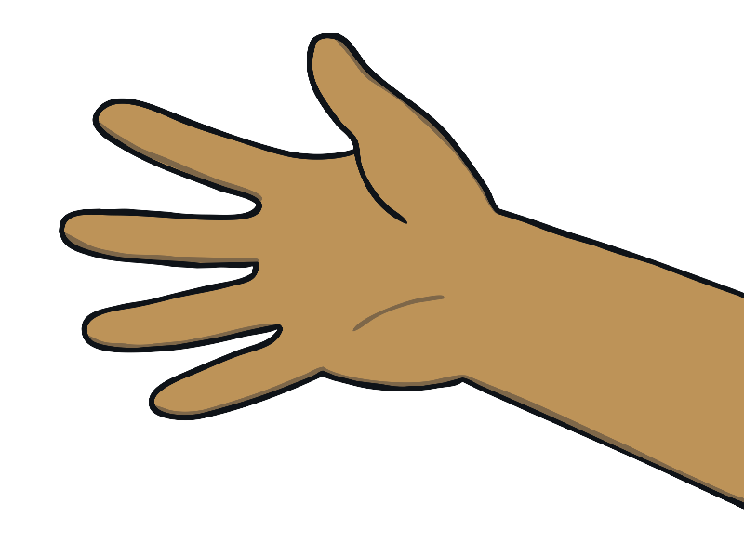
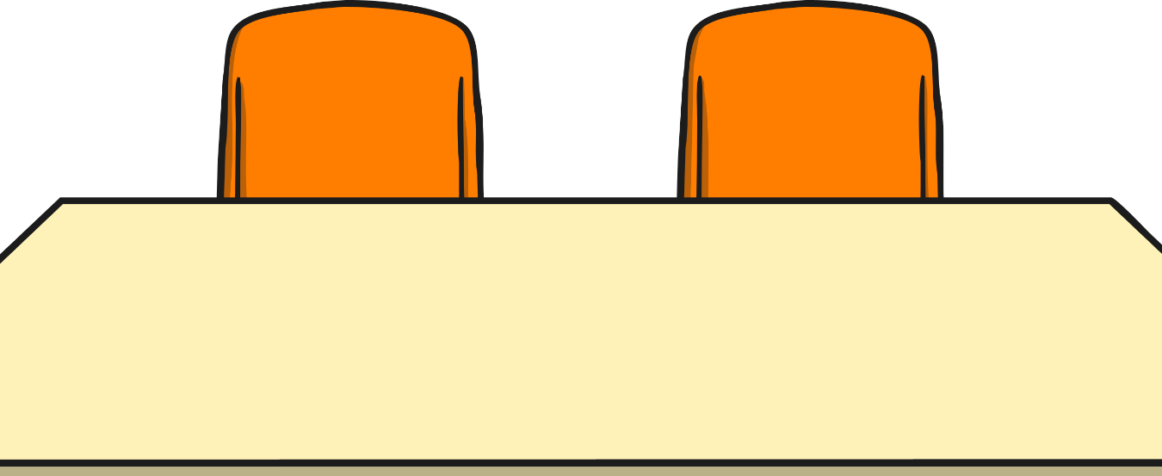


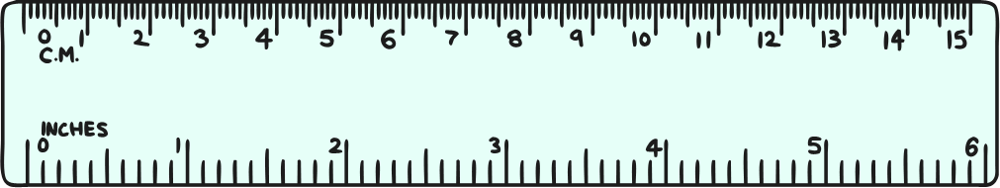

Show of Hands
Draw around your hand and cut it out.
In your group, order your hands from smallest to largest.

Slide 5
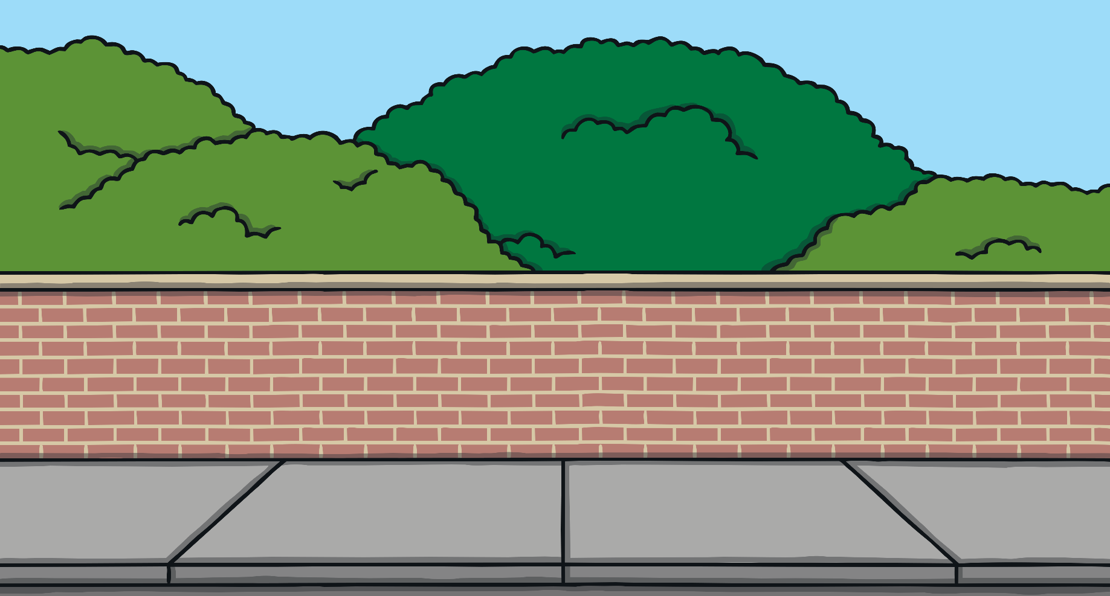
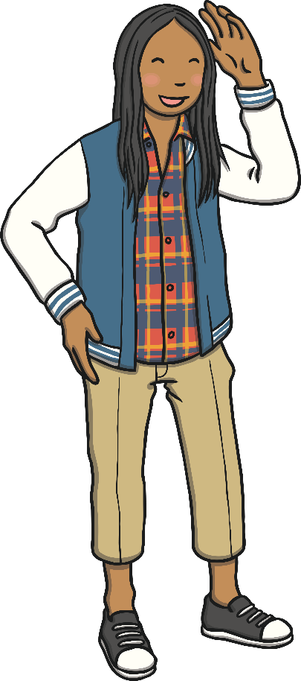
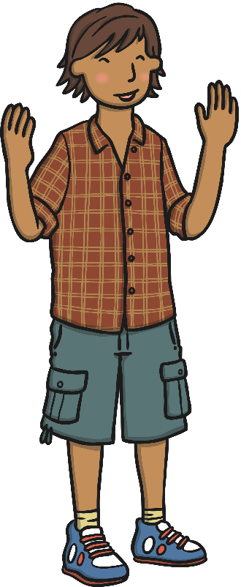
Length and Height
If we want to find out how tall or long something is, we can measure it.
When we measure, we use units so we can compare measurements and talk about them with other people.
We measure length and height in centimetres and metres.

Slide 6



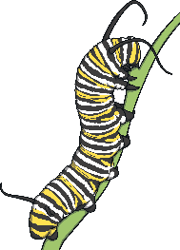
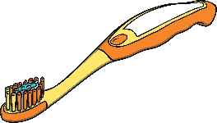

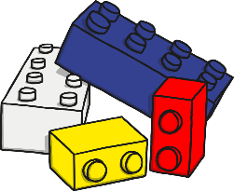
Length and Height
A centimetre is a small length or height.
You would measure these things in centimetres.
Your finger nail is about 1cm long.

Slide 7
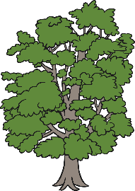
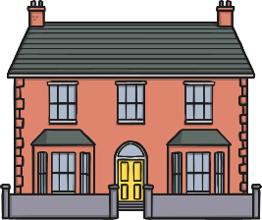




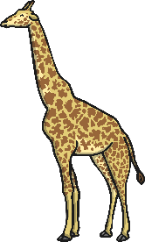
Length and Height
A metre is a long length or height.
You would measure these things in metres.
The door handle is about 1 metre high.

Slide 8

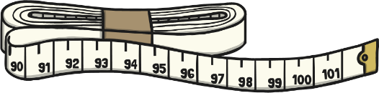
Tools
Rulers and tape measures are both tools we use to measure heights
and lengths.
Can you think of any more?

Slide 9
Tools
What could we measure with
a ruler?
What could we measure with
a tape measure?

Slide 10
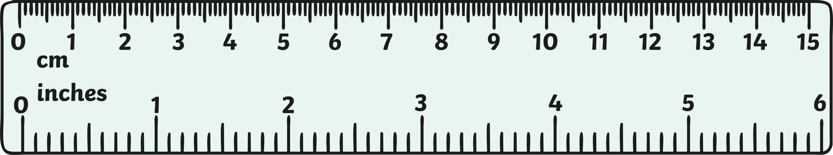

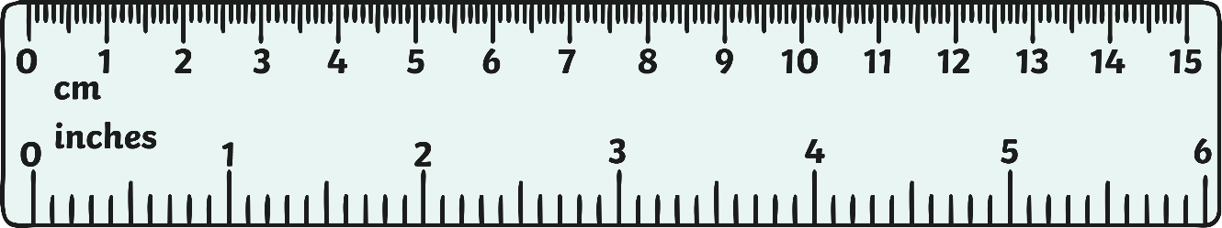

Tools
Look at the ruler. What do you see?
What do the markings on the ruler show?

Slide 11

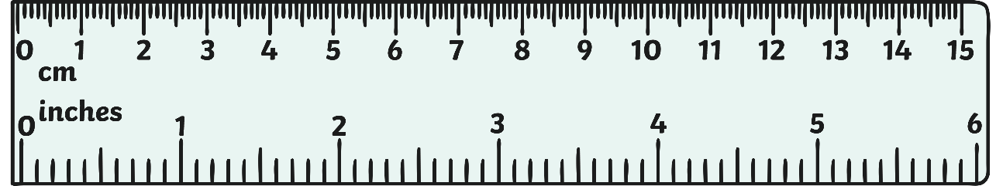
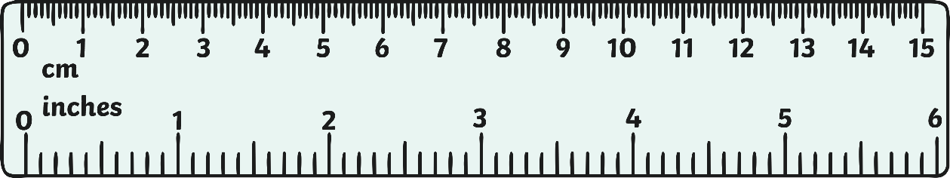
Tools
Some rulers have a gap between the end of the ruler and the 0 mark. With these rulers, you have to line up the thing you are measuring with the 0, not the end.
Some rulers start at the 0 mark. You can line up the thing you are measuring with the end of these rulers.

Slide 12

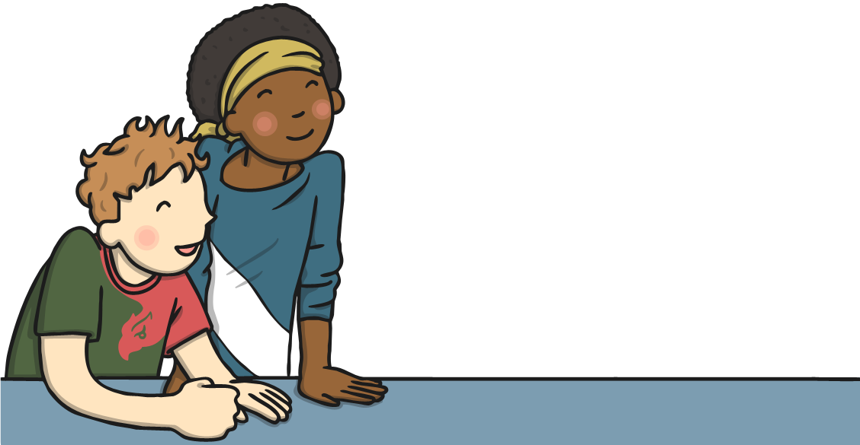


Cubes
Measure the tower of cubes with your partner.
Predict how tall your tower
is in centimetres
Line up the end of the tower with the 0cm mark on the ruler.
See how far up the ruler your tower comes.

Slide 13

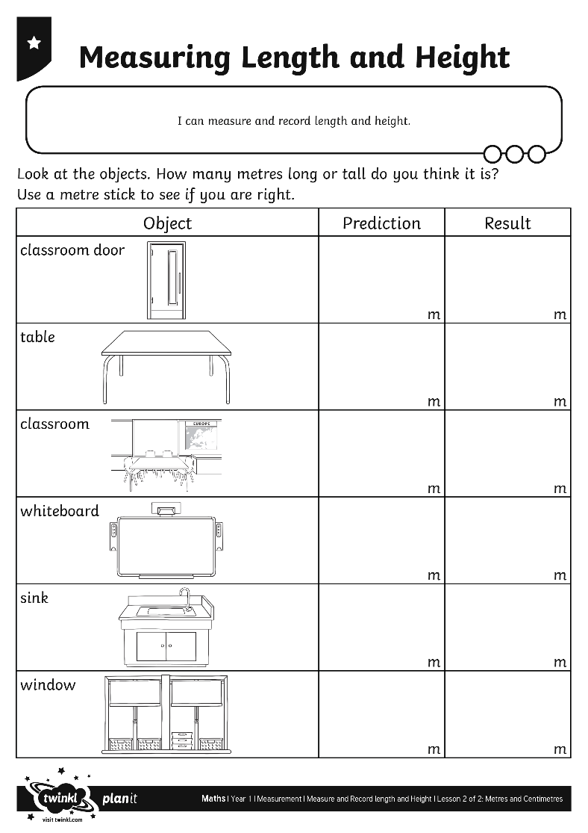
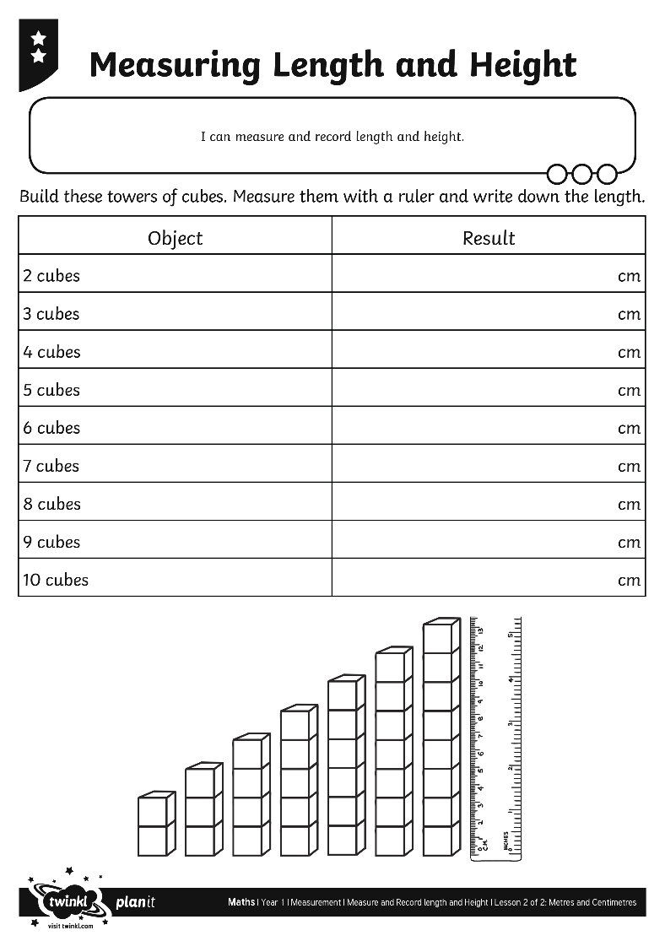
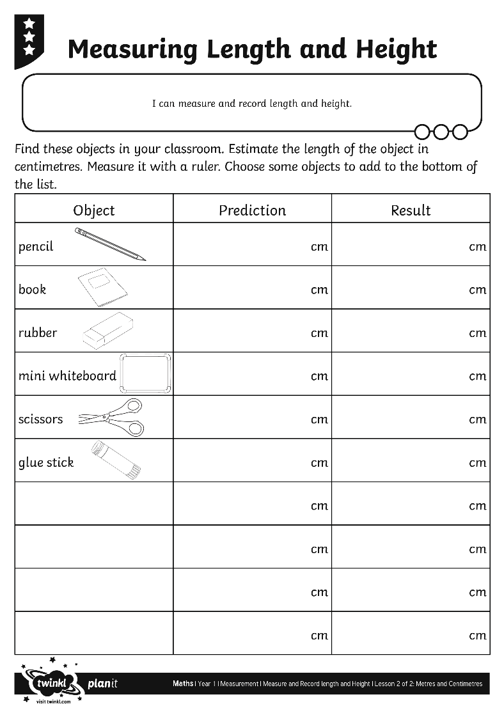
Measuring Length and Height

Slide 14

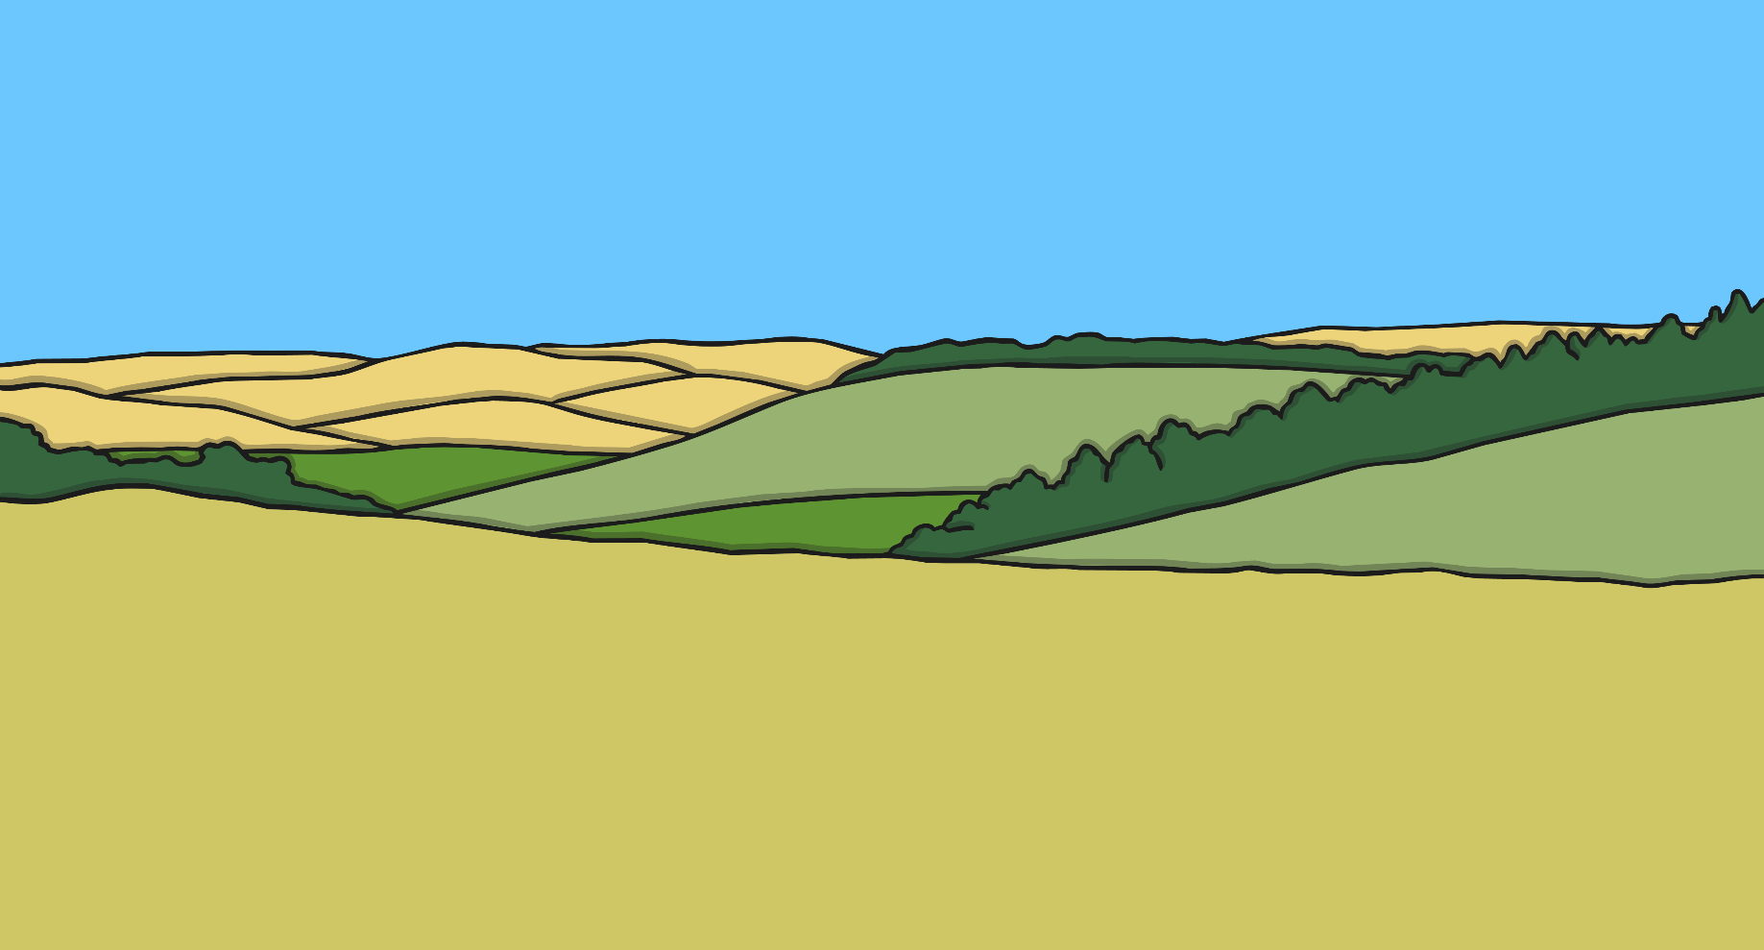
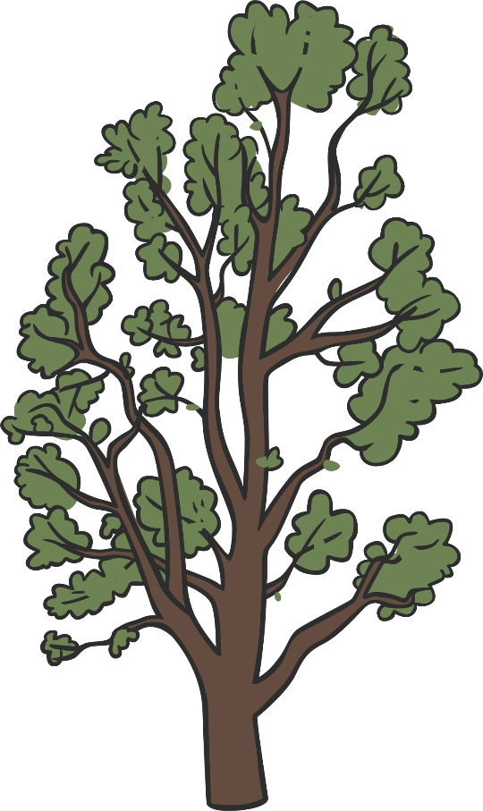

Metres or Centimetres?
Would you measure this tree in centimetres or metres? Explain why.

Slide 15
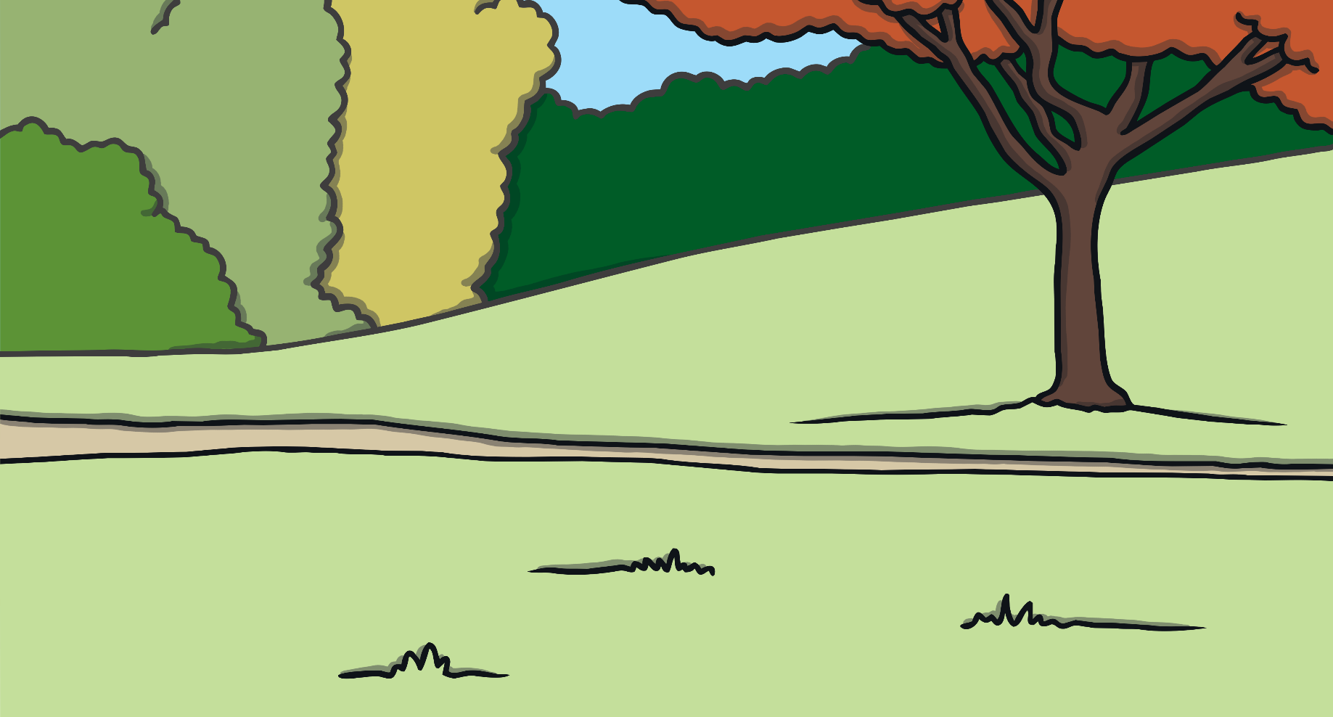
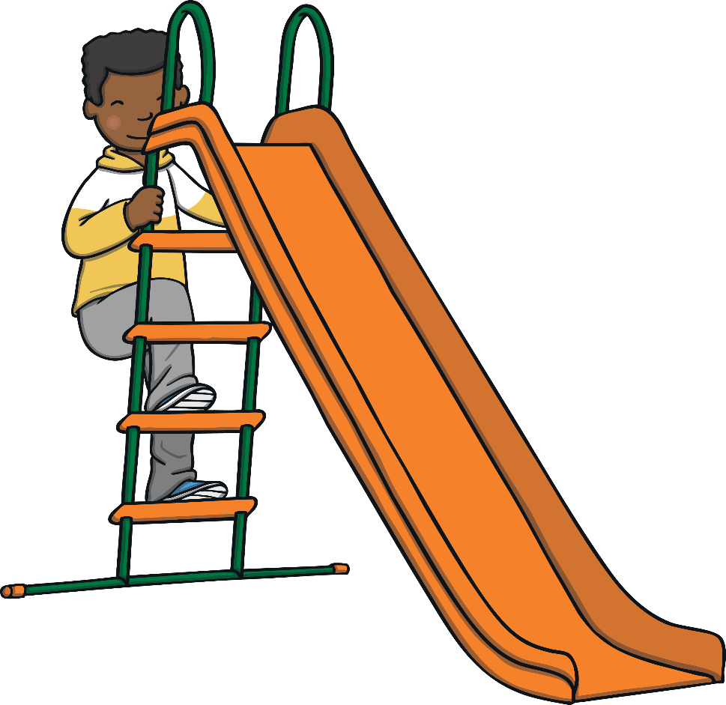
Metres or Centimetres?
Would you measure this slide in centimetres or metres? Explain why.

Slide 16



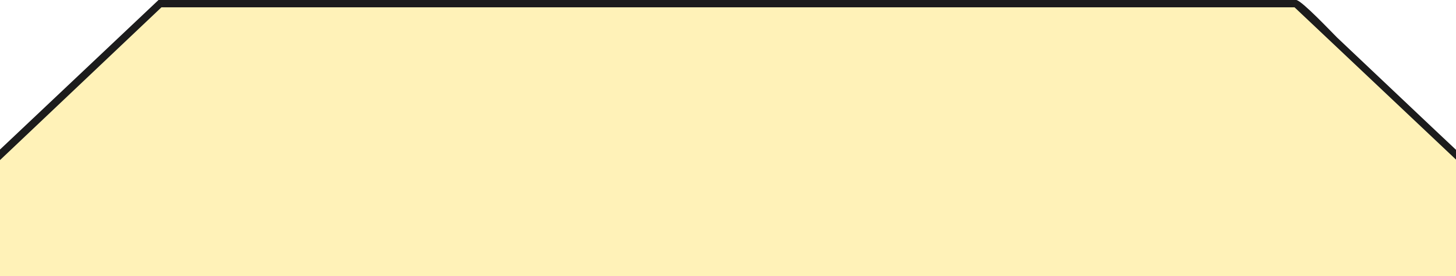
Metres or Centimetres?
Would you measure this pencil in centimetres or metres? Explain why.

Slide 17

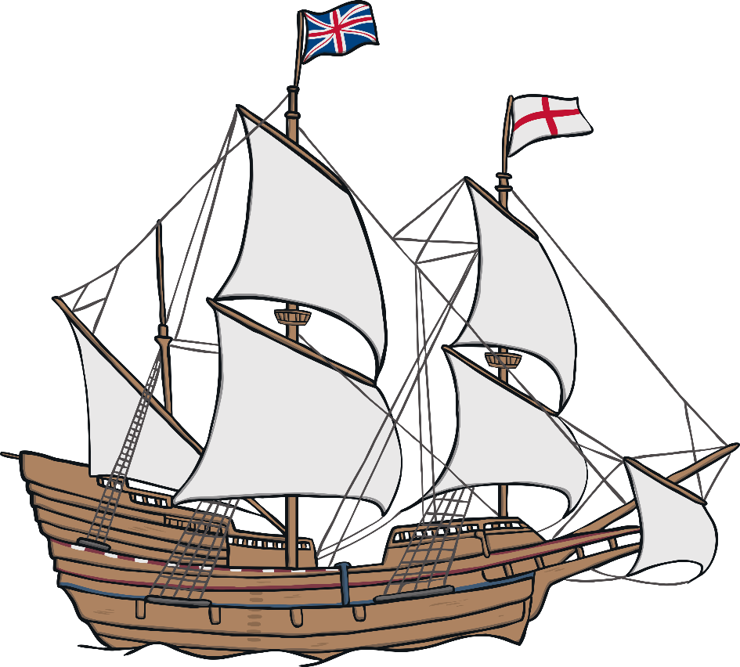
Metres or Centimetres?
Would you measure this boat in centimetres or metres? Explain why.

Slide 18
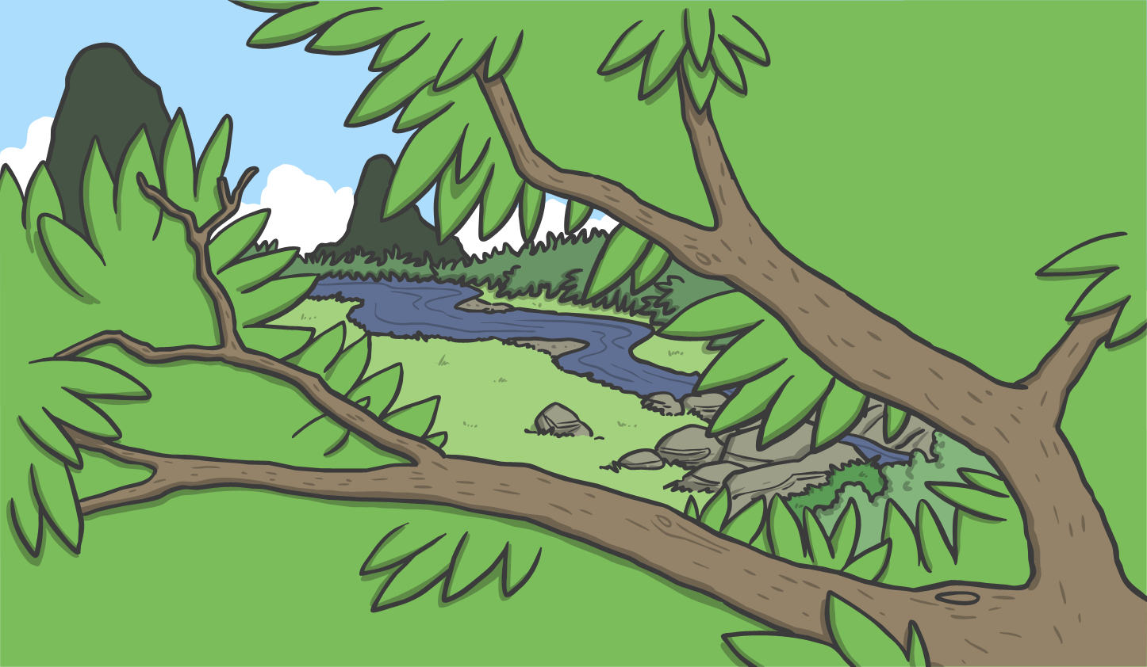
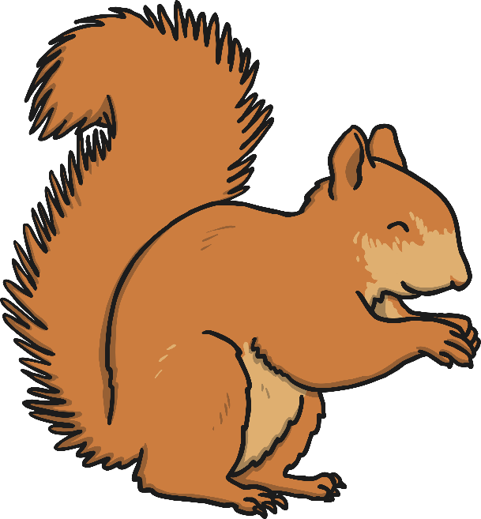
Metres or Centimetres?
Would you measure this squirrel in centimetres or metres? Explain why.

Slide 19
Aim
I can measure length and height using standard units.
Success Criteria
I can measure lengths and heights.
I can use the words ‘metre’ and centimetre’.

Slide 20


